Slide 1

DA376C Software Development for the Cloud
TreasureHunt
Jonathon Bisiach
Kristian Kokoneshi
Martijn de Redelijkheid

Slide 2

TreasureHunt
A cloud-based mobile and web application
Users create and undertake ‘treasure hunts’ in their local area
Locations on a hunt are signified by a single photo which hunters must identify and locate, whereupon they will given their next destination
Users create accounts, all information automatically encrypted in the cloud
Promotes teamwork, physical activity and local tourism

Slide 3
In this presentation
The Android application
The database
The web application
Security, ethical considerations & ideas for future work
A demonstration

Slide 4
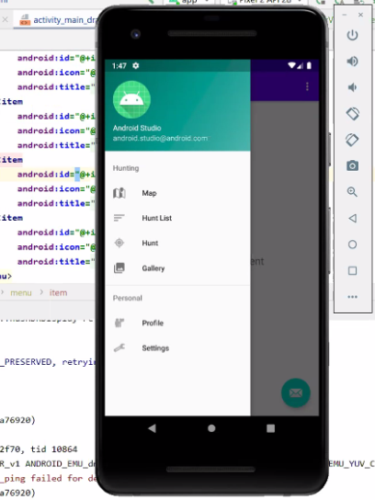
TreasureHunt Android application
Users can:
Register and login
Create locations
Browse nearby hunts
Select and perform hunts
Access to user menu features from a sliding menu drawer

Slide 5
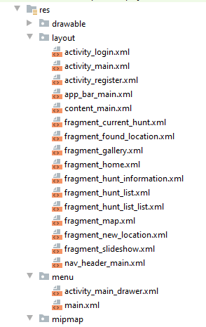
TreasureHunt Android application
User interface driven in-app by fragments

Slide 6
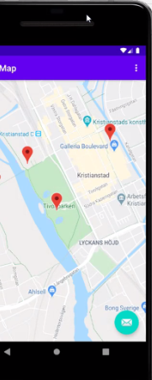
TreasureHunt Android application
To create a location, users:
Take a photo using the in-app camera.
Enter a location name and short description.
The created location and the photo are stored in the cloud database

Slide 7
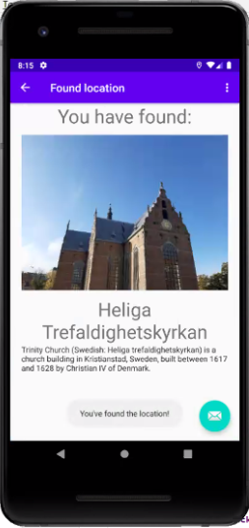
TreasureHunt Android application
To participate in a hunt, users:
browse hunts selected based on their geographical location (determined using GPS)
select a hunt based on the description and number of locations
find the first location based solely on the picture provided
users can request a hint if they are stuck, and will be provided a marker on the map
Once they proceed to the correct location, the GPS will trigger an alert telling the user they have reached their destination, and will be given the next location on the hunt, or end the hunt if it was the final location

Slide 8
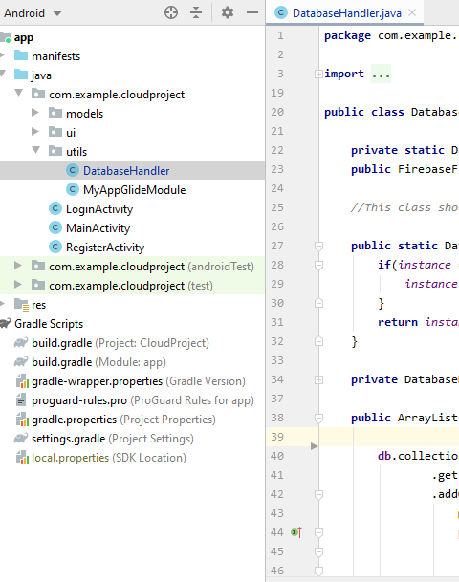
TreasureHunt Android application
A database handler utility class contains a Singleton class that is used to initiate all database calls
Each fragment makes database calls separately as needed to reduce latency

Slide 9


The database
Familiarity with the Firestore platform from previously using Firebase
Easy scalability
In-built security with automatic data encryption and decryption
Support for indexed queries
Reduced cost when compared with BigTable (and free trial use)

Slide 10

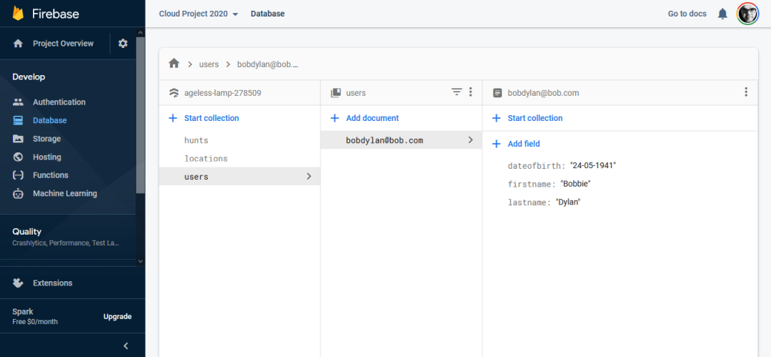
The FireStore database contains a hierarchical folder structure that contains user information, login details and the details of their hunts.

Slide 11
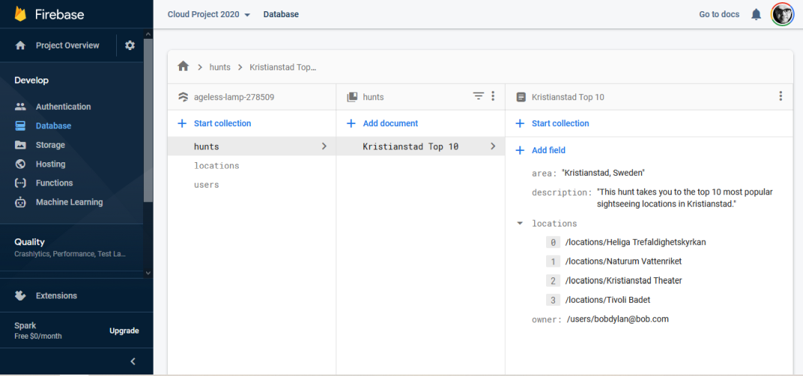
Hunts stored in the database contain the hunt name, a short description and the locations in order.

Slide 12
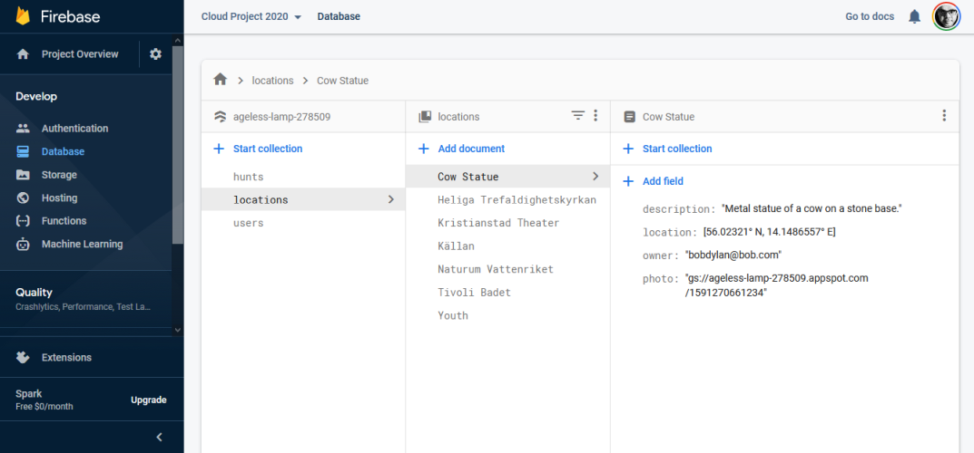
Each hunt location has contains a link to its corresponding photo in the Cloud Storage

Slide 13

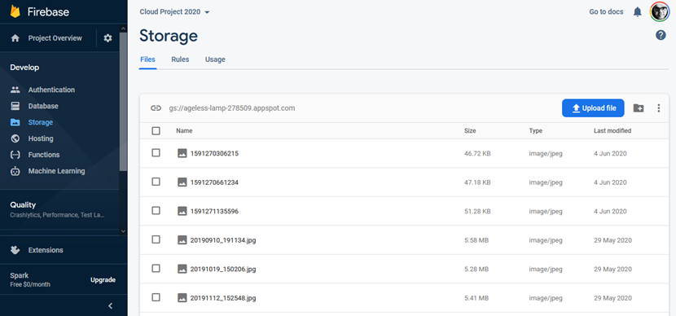
Photos are store in Google Cloud storage

Slide 14
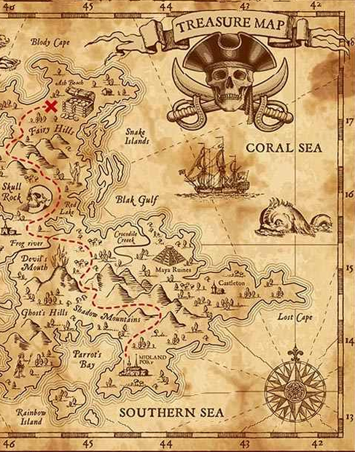
TreasureHunt web application
Users can:
Register and login
Create hunts
Browse existing hunts
Administrators can edit and delete inappropriate content

Slide 15
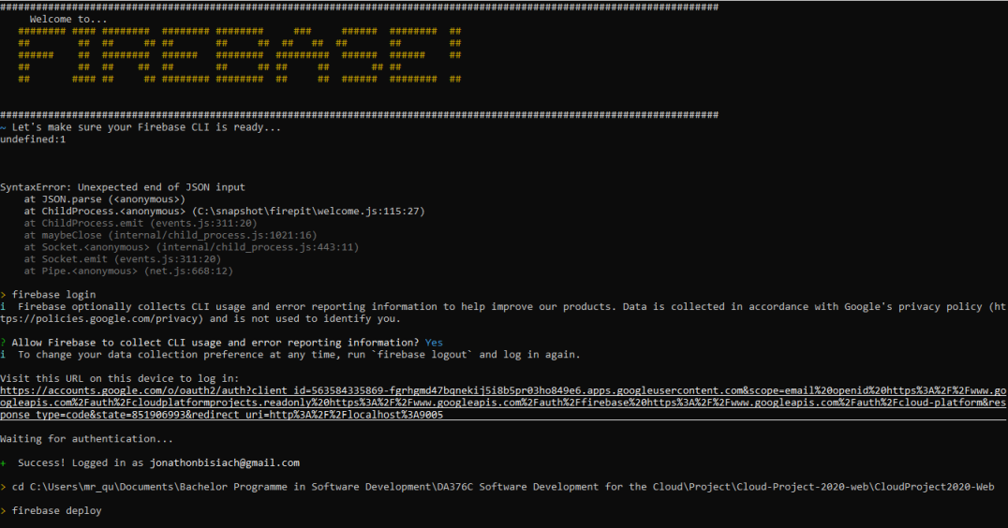

TreasureHunt web application
Created in Visual Studio Code & Atom using HTML and JavaScript
Hosted in Google Firebase
Firebase easy to run, directly connected to Firestore

Slide 16
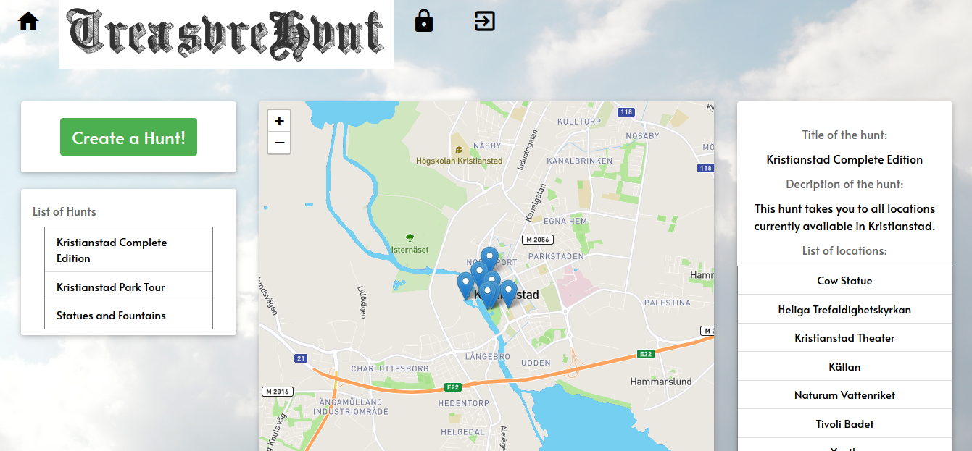
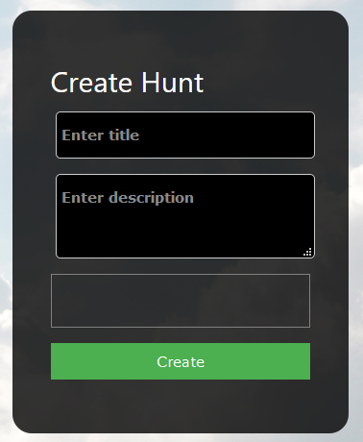
TreasureHunt web application
Browsing hunts works functionally the same as in the Android
The web application also allows for creating new hunts

Slide 17
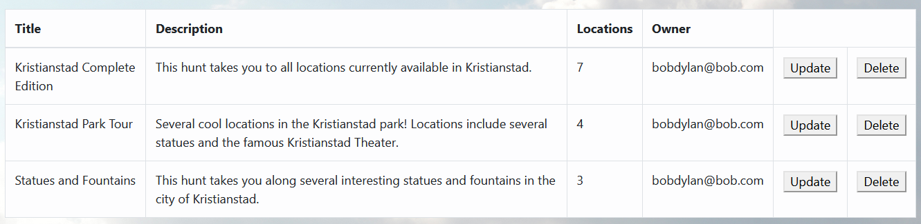
TreasureHunt web application
Administrators can edit hunts and remove inappropriate content

Slide 18
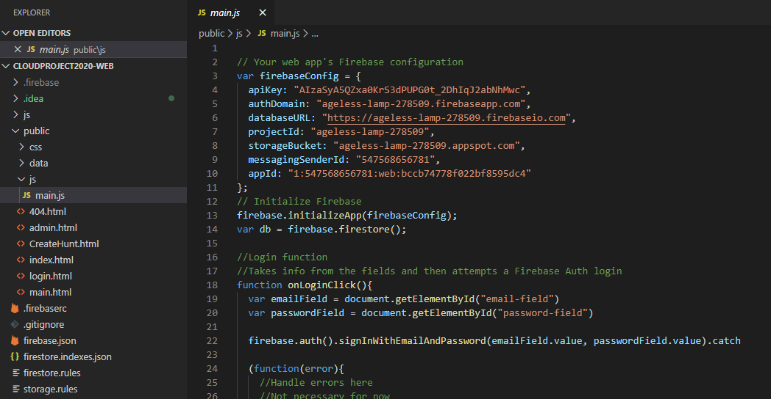
TreasureHunt web application
All calls to the database made using a single class in JavaScript
Once configured, database initialisation and login are all handled by Firebase
Methods for registering a new user, storing a new hunt and editing a hunt is all contained in this class.

Slide 19

Security
Login session management is handled automatically by Firebase
All user and hunt data is held server-side in the cloud database
Cloud Firestore automatically encrypts all data before it is written to disk
The data is automatically and transparently decrypted when read by an authorised user

Slide 20

Ethical considerations
With TreasureHunt we aim to promote:
teamwork
physical activity
local tourism
Through implementation on a Cloud platform, environmental resources and energy is conserved

Slide 21
Ideas for future work
More feature-complete user interface in Android and web applications
Android application records the distance travelled while on hunts
Implement user reward system for creating and participating in/winning hunts
More sophisticated hint system
Collaboration with local government/tourism agencies
Commitment to being completely carbon neutral/renewable

Slide 22
Now… a demonstration

